Slide 1
Exploring Kafka Connect Architecture

Slide 2
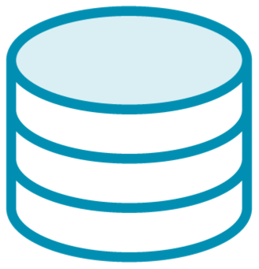



Data Flow
Source
Kafka Connect
Kafka Broker
Kafka Connect
Sink

Slide 3
Kafka Connect Architecture
Source
Kafka Connect
Apache Kafka
Sink

Slide 4

Kafka Connect Architecture
Source
Kafka Connect Kafka Connect
Apache Kafka
Kafka Connect
Sink

Slide 5

Kafka Connect Architecture
Kafka Connect
Source
Apache Kafka
Sink

Slide 6


Kafka Connect
Streaming
Batching

Slide 7
Workers

Slide 8



Kafka Connect Worker
Kafka Connect Process
JVM
OS
Container

Slide 9

Standalone
Distributed
Work is shared and balanced across multiple nodes
All work is performed in a single process

Slide 10





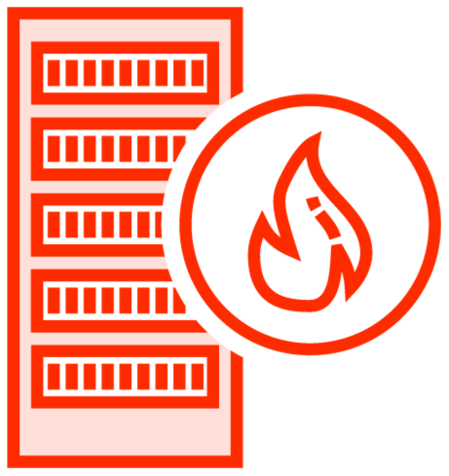

Kafka Connect Worker(s)
Standalone
Distributed ( Cluster )
Deploy
Maintain
Fault Tolerant
Scalable
Development Environments
Production (Like) Environments

Slide 11






Kafka Connect Standalone
OS / Container
OS / Container
OS / Container
Source
Standalone Worker
OS / Container
Apache Kafka
Connector(s) Configuration
Offset Storage
Sink
offset.storage.file.filename

Slide 12







Kafka Connect Distributed
OS / Container
 |  | OS / Container
Worker 1
OS / Container
Apache Kafka
config-storage-topic
Source
 |  | OS / Container
Worker 2
offset-storage-topic
OS / Container
status-storage-topic
……………………….....
Sink
Kafka Connect Cluster

Slide 13
Connectors

Slide 14

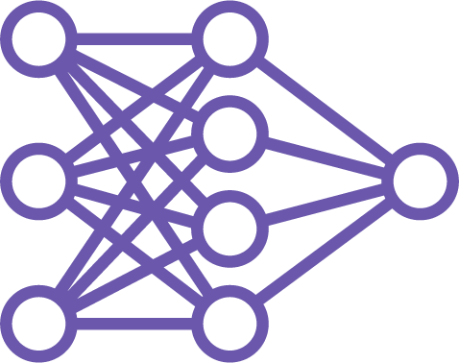
Connectors
Connector ( Plugin )
An adapter that allows connecting to/from a common system
Connector ( Instance )
A job that enables the exchange of data between Kafka and other systems

Slide 15



Connectors
OS / Container
Application Level ( Java Process )
Worker
Code Level ( JAR files )
Base Code
Connector

Slide 16
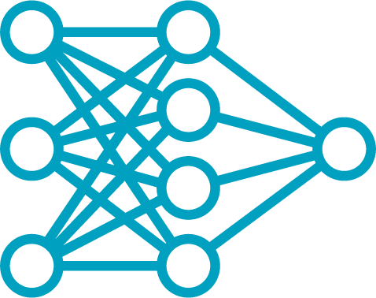
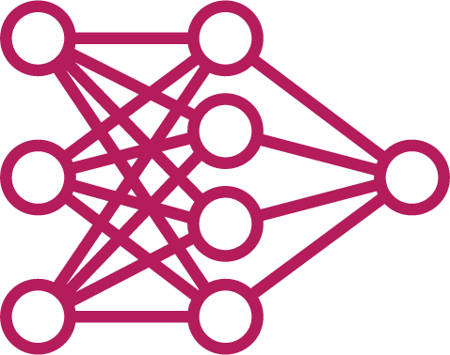
Connectors
OS / Container
Runtime Level ( Thread )
Connector 1 Connector 2
Worker
Application Level ( Java Process )
Code Level ( JAR files )
Base Code
Connector

Slide 17




Connectors
Kafka Connect Worker
Globomantics Connector Instance
Globomantics
WeatherDB Connector Instance
Kafka Broker(s)
WeatherDB
Debezium Connector

Slide 19

Demo
Set up Elasticsearch
Add Elasticsearch Sink Connector

Slide 20
Tasks

Slide 21
Connectors
OS / Container
Runtime Level ( Thread )
Connector 1 Connector 2
Worker
Application Level ( Java Process )
Code Level ( JAR files )
Base Code
Connector

Slide 22
Tasks
OS / Container
Runtime Level ( Thread )
C1 Task 1 C1 Task 2
C2 Task 1
Worker
Application Level ( Java Process )
Code Level ( JAR files )
Base Code
Connector

Slide 23


Kafka Connect
Apache Kafka
Connector
( Instance )
Topic
Tasks
Partitions

Slide 24


Tasks
Kafka Connect
Apache Kafka
Worker 1
Broker 1
task-0
partition-0
task-3
partition-3
Worker 2
Broker 2
task-1
partition-1
task-0
partition-0
Worker 3
Broker 3
task-2
partition-2

Slide 25



Tasks Rebalancing
Worker 1
Worker 2
Worker 3
task-0
task-1
task-2
task-3
task-0
task-0
task-1
Connector 1 Instance
Connector 1 Instance 2
- Connector 2 Instance

Slide 26
Changing the number of workers
Tasks rebalancing
Demo
REST Client:
Insomnia
Postman

Slide 27


Tasks Rebalancing
Worker 1 ( 8083 )
Worker 2 ( 8084 )
elastic-task-0
articles-task-0

Slide 28

Tasks Rebalancing
Worker 1: 8083 elastic-task-0
Worker 2: 8084 articles-task-0

Slide 29
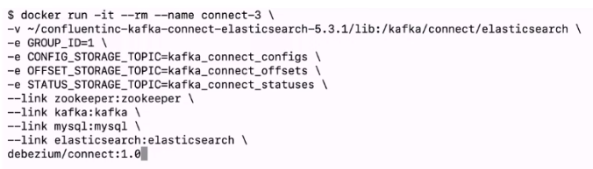
Tasks Rebalancing
Worker 1: 8083 elastic-task-0
elastic-task-2
Worker 2: 8084 articles-task-0
elastic-task-1
elastic-task-3
Worker 3 elastic-task-1

Slide 30
Tasks Rebalancing
Worker 1: 8083 elastic-task-0
elastic-task-2
Worker 2: 8084 articles-task-0
elastic-task-1
elastic-task-3
Worker 3

Slide 31

Tasks Rebalancing
Worker 1: 8083 elastic-task-0
elastic-task-2
Worker 2: 8084
elastic-task-1
elastic-task-3
Worker 3 articles-task-0

Slide 32
Summary
Kafka Connect Architecture
Workers Connectors Tasks

